Slide 1
Analysing Lexical Semantic Change in Chinese Language Using Word Embeddings
Hanzhi Zhang
Notes:
My topic is “Analysing Lexical Semantic Change in Chinese Language Using Word Embeddings”. Lexical Semantic Change is part of the evolution of a language, which has been a popular subject in linguistic studies and attracted considerable attention from fields like sociology, for evolution of languages can reflect changes in culture and society; In recent years, the emergence of word embedding enabled the mining of semantic changes from large-scale diachronic corpora, but most of the work has been done on English, and very few have studied the Chinese language.

Slide 2
Lexical Semantic Change/Shift
A class of “innovations which change the lexical meaning rather than the grammatical function of a form” (Bloomfield, 1923)
Narrowing: ‘mete’ (solid food) --> ‘meat’ (animal flesh)
Broadening: ‘dogge’ (breed of mastiff and bulldog) --> ‘dog’ (general term)
The Computational Approach: automatically detect or “mine” semantic changes from large diachronic corpora
Is semantic change associated with a word’s frequency of use?
How does a word’s polysemy affect the stability of its meaning and usage?
Bloomfield, L. Language. George Allen & Unwin Ltd, London, 1923.
Notes:
Lexical Semantic Change is defined as “innovations which change the lexical meaning of a form”. Here are examples from old English, “narrowing” of the word meat from any solid, edible food to animal flesh, and broadening of the word dog from a breed of dog to the entire species. Traditionally, studies on semantic change are mostly qualitative, though some quantitative work have been done on relatively small human annotated datasets. The motivation for introducing a computational approach is to automatically detect semantic changes, to perform case studies, and to statistically analyse patterns, answering questions like: Is semantic change associated with frequency of use? Or how does a word’s polysemy affect its stability?

Slide 3
Semantic Change Detection/Computation
Static word embeddings (e.g., Mikolov’s Word2Vec)
Temporal/diachronic/dynamic word embeddings: trained + compared across time periods (bins, slices). --> Challenge: alignment
Train separately, apply orthogonal Procrustes to align (Hamilton’s HistWords)
Keep shared, global context embedding frozen and update target embedding on each time slice, or vice versa (Di Carlo’s TWEC)
Mikolov, T. et al. Distributed representations of words and phrases and their compositionality. 2013.
Hamilton, W. et al. Diachronic word embeddings reveal statistical laws of semantic change. 2016.
Di Carlo, V. el at. Training Temporal Word Embeddings with a Compass. 2019.
Notes:
This can be done using distributional word embedding models, which represent lexical meaning with dense vectors produced from co-occurrence relationships. We have static word embeddings like Word2Vec, based on the hypothesis that a word is characterized by the company it keeps, a further assumption is if its company changes, then the meaning also might have changed. Thus it makes sense for us to have temporal word embeddings trained on time-specific text. Due to the randomness of initialization, the word embeddings trained on separate text will not naturally fall into the same vector space, so they must be aligned for comparison. There are two main strategies, one is to train separately and align afterwards, the other is to keep a shared, global context embedding fixed and update target embedding on each time slice.

Slide 4
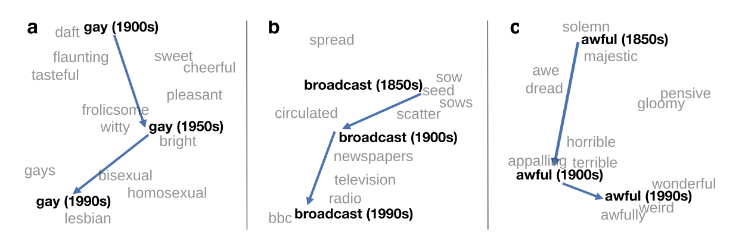

Semantic Change Detection/Computation
Temporal/diachronic/dynamic word embeddings
Metric: cosine distance/similarity
Degree of change: a word’s embedding from different time slices
Hypothesis: a significant difference between $e_{1}$ and $e_{2}$, the embeddings of word $w$ from time slices $t_{1}$ and $t_{2}$, would suggest a major change in $w$’s meaning and usage between $t_{1}$ and $t_{2}$, vice versa
Proof: compare the cosine similarity scores to human judgement
Direction of change: a word’s neighbours from different time slices
Notes:
So how is semantic change presented in these embeddings? Our hypothesis is if there is a significant difference between embeddings from different time slices, it would suggest a major change in the word’s meaning. This is the degree of change, as for the direction, we would look at its neighbourhood. (pic!) Here are some examples, you can see how the word “gay” changes from a neighbourhood from sweet, cheerful to homosexual, lesbian, bisexual; how “broadcast” changes from scattering, sowing seeds to transmitting information by radio, newspaper or television; and how “awful” goes from awe-inspiring, majestic to something bad and unpleasant.

Slide 5
Semantic Change Detection/Computation
Flaws for using a single representation for each time slice
How a word changes in its dominant sense
May or may not be able to capture more complex changes
Contextualised word embeddings (e.g., Devlin’s BERT)
A word with different contexts can yield different representation
Word embedding --> “sense” embedding
Advantage: can model different meanings and usage of polysemy words
Devlin, J. et al. BERT: Pre-training of Deep Bidirectional Transformers for Language Understanding. 2018.
Notes:
There is a main flaw when using a single representation for each time slice, for it can only detect how a word changes in its dominant sense. This may be effective when the old meaning completely died out, like gay, we rarely would use “I’m gay” as “I’m happy” anymore. But it would not be as effective when an old meaning remains, for example, the word “mouse” gained a new meaning, device to move cursor on a screen, but it is also still the animal mouse. Contextualised embeddings like BERT are superior in the way that they can yield different representations for a word in different contexts. So, for polysemy words we can use “sense” embeddings to model and calculate how the senses evolve overtime.

Slide 6
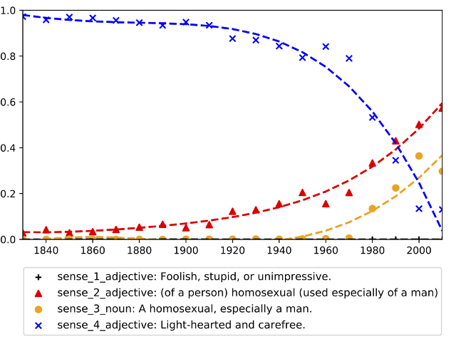
Semantic Change Detection/Computation
Contextualised word embeddings: how to distinguish “senses”?
Supervised: dictionary --> sense representation
Unsupervised: clustering
Metrics: a word’s distribution among sense clusters at different times
Across time slices, measure how the size of each cluster changes
Across clusters, measure the percentage of occurrence from each time slice
Degree of change: very difficult to generate a single score!
Direction of change: from shrinking sense clusters to growing ones
Notes:
So how do we distinguish “senses”? There is the supervised approach, building sense representations from a dictionary and allocating each occurrence to the nearest target sense, also the unsupervised approach, clustering. The contextualised embeddings are worse at measuring degree of change, but it is more human interpretable in showing the direction. (pic!) Again we take “gay” as an example, its meaning shifts from shrinking sense clusters, blue line for “light-hearted, carefree” to growing ones, red line for adjective “homosexual” and yellow for noun “homosexual person”.

Slide 7
Diachronic Corpora
English: Corpus of Historical American English, 1820s-2010s
News: New York Times Annotated Corpus, 1987-2007
Old English: The Helsinki Corpus of English Texts, c.750-c.1700
Spoken: The Diachronic Corpus of Present-Day Spoken English, 1958-1992
Internet: JISC UK Web Domain Dataset, 1996–2013
Chinese: CCL (Center for Chinese Linguistics) Corpus, 1870s-2020s
(Only open to queries, unable to download full-text; very unbalanced)
News: People’s Daily, 1946-2023
Ancient: Sheffield Corpus of Chinese, Pre-Qin to Qing dynasty
Notes:
Whatever embeddings we use, we are going to need a diachronic corpus, in English we have the Corpus of Historical American English, which is probably the largest and most comprehensive; there are also smaller and more specific ones for news, old English, spoken and Internet English. In Chinese we don’t have as many open resources. I am currently working with the People’s Daily News Corpus, the advantage of news is they are sensitive to events and changes in society, the disadvantage is a lack of variability in style and format.

Slide 8
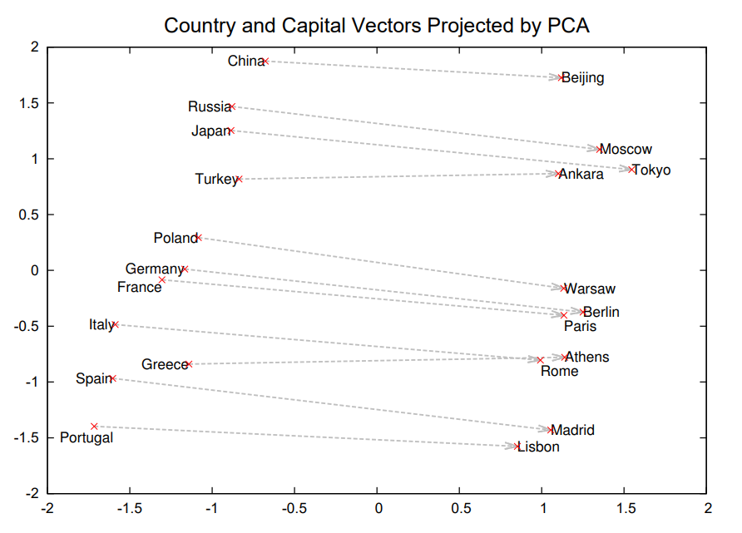
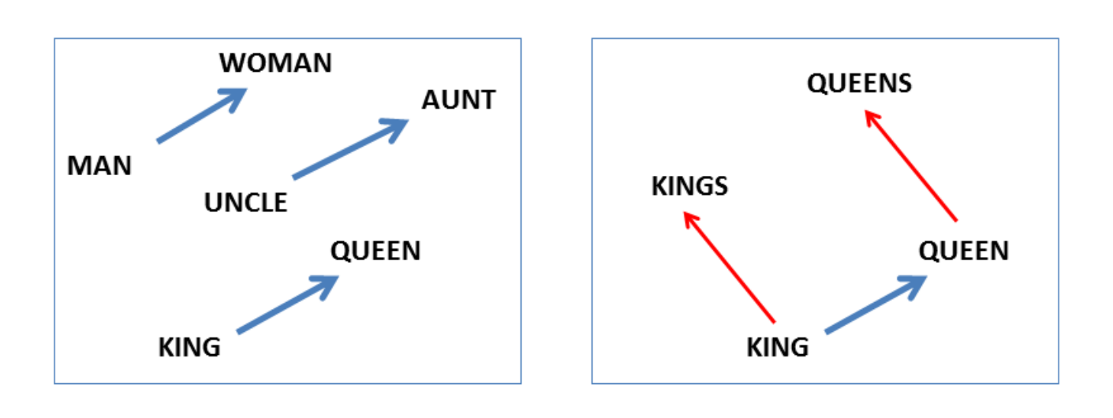
Testing and Evaluation
Quality of static word embeddings
Word Similarity/Relatedness Test: Spearman correlation on human-labeled scores and scores (cosine similarity) generated by the embeddings
Word Analogy Test: Accuracy on analogy task (“man : woman :: father : X ”, where X should be ‘mother’ chosen by cosine similarity)
Quality of aligned temporal embeddings
Temporal Similarity/Relatedness: changing scores generated by calculating human ratings on semantic relatedness across a variety of usage pairs
Temporal Word Analogy: also based on facts/common knowledge (“Ronald Reagan : 1987 :: Bill Clinton : 1997”, “Walkman : 1987 :: iPod : 2007”)
Notes:
And for evaluating the quality of embeddings, for static embeddings we have the Word Similarity or Relatedness Test: Spearman correlation on human-labeled scores and scores generated by the embeddings, and the Word Analogy Test: (picture!) Accuracy on analogy task like Man is to woman as father is to mother, Paris is to France as Madrid is to Spain. For temporal embeddings we also have these two tasks, similarity based on human judgements and analogy based on facts, for example, Regan in 1987 is like Clinton in 1997, or Walkman in 1987 is like iPod in 2007.

Slide 9
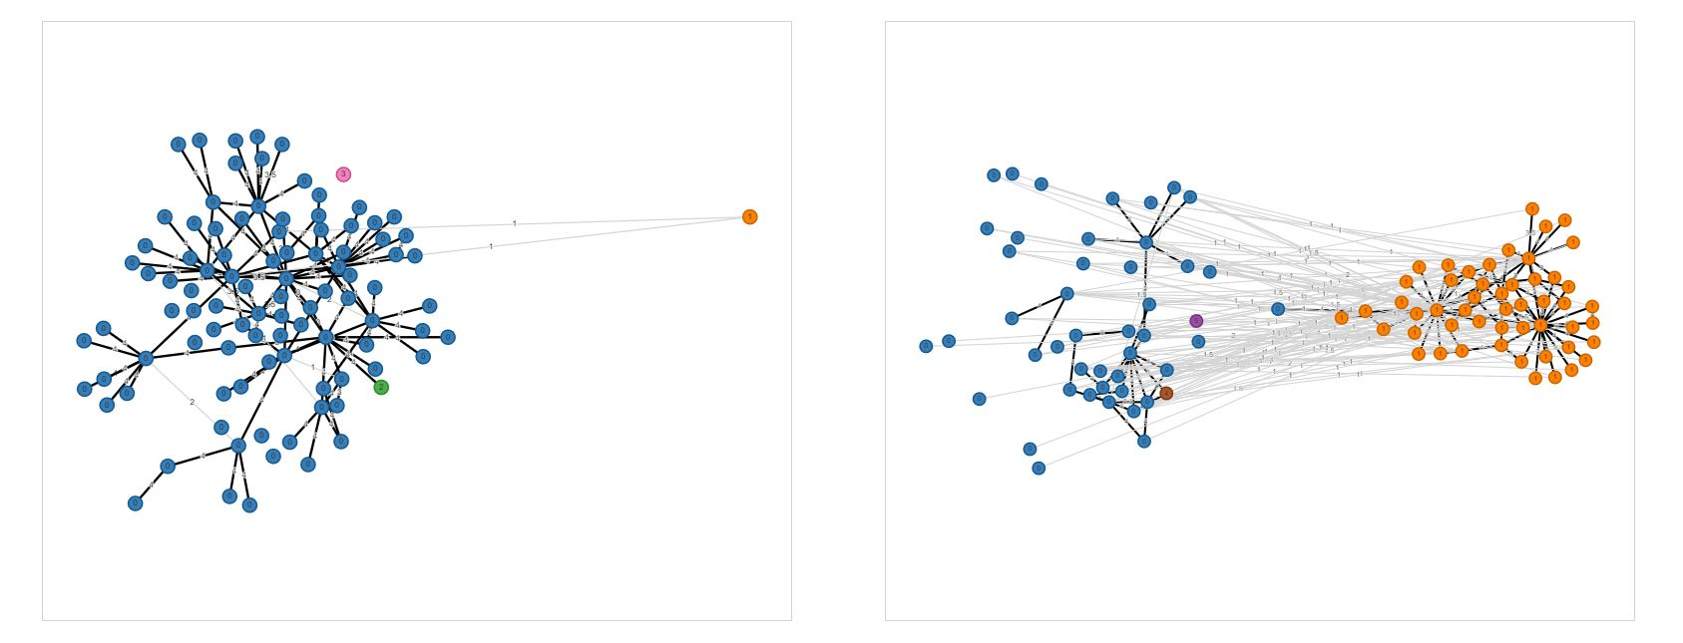
Testing and Evaluation
Metrics for the semantic change detection task
Binary classification: decide which words lost or gained sense(s)
Ranking: rank words according to their degree of change
The DURel Annotation Tool (Schlechtweg, 2018), evaluation dataset DWUG and Chinese version ChiWUG (Chen, 2023)
4: Identical 3: Closely Related 2: Distantly Related 1: Unrelated
graft (n.): “a transplanted piece of living tissue” --> “practice of bribery”
Schlechtweg, D. et al. DURel: A framework for the annotation of lexical semantic change. 2018.
Chen, J. et al. ChiWUG: A graph-based evaluation dataset for Chinese lexical semantic change. 2023.
Notes:
There are also metrics designed specifically for the semantic detection task, there is binary classification, change or no change, and ranking, degree of change. A quite mature and widely-used dataset is constructed using the Diachronic Usage Relatedness Annotation Tool, where human annotators rate each pair of “usage” on a scale from 1 to 4, (pic!) the ratings are then used to generate time-specific graphs, like for the word “graft”, whose meaning changes from the shrinking blue cluster representing the sense “transplanted tissue”, to the growing orange one represents “bribery”. The task eventually requires predicting a score for degree of change. A dataset on Chinese using the same tool was published last year.

Slide 10
Current Status
Tasks: SemEval-20 Task 1 (English, German, Latin, Swedish)
Static (e.g., Word2Vec based) outperforms contextualised (e.g., BERT based) models on binary classification and ranking tests
Works on Chinese semantic change: mostly qualitative case studies with a few examples to suggest potential in the field
Schlechtweg, D. et al. SemEval-2020 Task 1: Unsupervised Lexical Semantic Change Detection. 2020.
Kutuzov, A. et al. Diachronic word embeddings and semantic shifts: a survey. 2018.
Montanelli, S. & Periti, F. A Survey On Contextualised Semantic Shift Detection. 2023.
Notes:
For the field of Semantic Change Detection, there are plenty of resource in English. Researchers have also been working with other European languages, but most of the models and methods are testing and competing on English. Contrary to the assumption that contextualised embeddings are more informative, the SoTA performances on ranking tasks are more often achieved using static models. Works on Chinese semantic change are limited, and since the test set only came out recently, they are done without a shared, common evaluation metric.

Slide 11
Project Outline
The construction of a diachronic Chinese corpus (✔)
People’s Daily news articles 1946-2023 (4.09 GB)
Develop one optimal pipeline for the static (Word2Vec based ✔) model and one for the contextualised (BERT based) model
Preprocessing: tokenisation, removal of stop words and punctuation, etc.
Word2Vec: parameter tuning (choosing from SGNS and CBOW, train separately-align vs. frozen atemporal compass)
Compare my cosine distance to the ChiWUG score of change
Notes:
Here is the project outline. My project involves the construction of a diachronic Chinese corpus, which I have finished crawling from the Newspaper’s official digital library; I have been experimenting with the Word2Vec based models to develop an optimal pipeline on the Chinese Word Usage Graphs ranking task, cosine distance of target word’s embeddings from the two time slices are compared against the score of change. So far, the optimal combination is the PKUseg tokenizer, the Skip-gram with Negative Sampling version of Word2Vec aligned using a frozen atemporal compass.

Slide 12
The Optimal Pipeline
BERT: experiment with
Pre-trained model vs. incremental fine-tune (on each time slice)
Layer(s) from which contextualised word representations are extracted (last one, last two, last four, all, etc.)
Pooling strategies (average, max, concatenation)
Clustering methods ((K-Means, DBSCAN, graph-based)
Compare cosine similarity between contextualised word embeddings to human rated word usage “relatedness” score (correlation)
Compare my clustering to the ChiWUG usage clusters (accuracy)
Notes:
The next step would be to build another BERT-based pipeline experimenting with different pre-trained models, whether to perform incremental fine-tune on each time slice, which of the hidden layers to extract the word embeddings from, which pooling strategies to use, and different sense clustering methods. We then compare the contextualised word embeddings to human rated word usage “relatedness” scores to maximize correlation. And test the clustering against the Chinese world usage graph clusters to maximize accuracy, where the ideal would be for each pair of usages, the model would group them to the same cluster if and only if they also appear in the same cluster by human judgement.

Slide 13
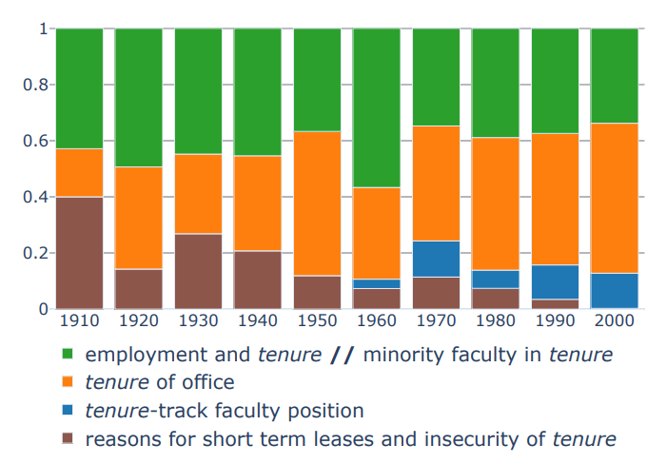
Project Outline
Exploratory studies using the optimal pipelines
If we are confident that lower cosine similarity across time correlates with higher degree of changes in meaning, we could:
Suggest new words that may have gone through semantic change
Study the correlation between degree of change and frequency/polysemy
For words we picked out, we can analyse them linguistically by:
Drawing a trajectory of temporal embeddings with their neighbourhood
Visualising how the sense clusters change over time
Notes:
Note that despite we are using metrics like accuracy and correlation scores to improve the pipeline, the tasks only cover a handful of words from limited time periods, so they only provide a small part of the overall picture. After confirming the models are robust and reliable, we could do some more exploratory work, suggesting new words with potential meaning changes and generating statistical rules. Also, we can do some linguistical analysis, (picture!) like drawing a trajectory of how the word changes, (picture!) and visualizing how sense clusters evolve over time.

Slide 14
Chinese Temporal Word Embeddings
WordSim-240, WordSim-296: Spearman correlation
The SoTA system VCWE (Sun, 2019): 57.81, 61.29
Static Word2Vec on the entire corpus (1956-2024): 57.83, 57.22
Temporal Word2Vec 1954-1978: 49.45, 49.82
Temporal Word2Vec 1979-2003: 56.05, 57.58
1,225 analogies (capital/country, province/city, family relationship)
The SoTA system JWE (Yu, 2017): 0.91, 0.93, 0.62, 0.85 (all)
Static Word2Vec on the entire corpus (1956-2024): 0.71, 0.97, 0.74, 0.76 (all)
Temporal Word2Vec 1954-1978: 0.50, 0.54, 0.32, 0.46 (all)
Temporal Word2Vec 1979-2003: 0.77, 0.89, 0.46, 0.71 (all)
Notes:
Next I’m going to talk about my progress so far. Recall the time-independent tasks to test the quality of static embeddings, the results on our news corpus and the later time slice is not so much worse than the state-of-the-art, so we can say the corpus is big enough to train effective embeddings, and alignment strategy does not affect robustness within a time slice. It also makes sense for the earlier time slice to have lower scores, because the test set is constructed recently, so for analogy tasks like Paris is to France as Moscow is to Russia, the embedding trained on earlier text would give the outdated answer “Soviet Union”.

Slide 15
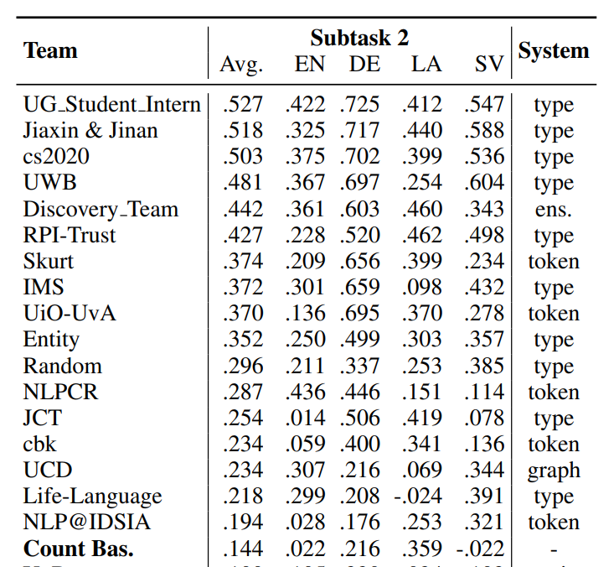
Testing on ChiWUG Dataset
Spearman score: 0.426 (40 words)
0.674 on 28 two-character words
-0.014 on 12 one-character “words”
Doubts on the one-character “words”
“热”: v. to heat sth. up
adj. hot, popular, eager, thermal
热门 hot, popular
热电站 thermal power plant
热心家 hot(warm)-hearted person
Notes:
As for the Chinese Word Usage Graph, we already mentioned it is a new dataset, with no baseline or benchmark to compete against, But we can refer to SemEval2020, constructed using the same annotation tool; on different languages, the best scores range from .4 and .7 with an average of .5, while our best performance on Chinese so far is .426. We also note the score on two-character words are much better than one-character words, but when we look at the usages used for annotation, there are cases like “热”, a polysemy character that can appear in words like 热门, popular, 热电站, thermal power plant and 热心家, warm-hearted person, where the character is clearly not a Chinese “word” unit on its own but part of some longer words, so I would argue one-character “words” are inappropriate and should be excluded from the test.

Slide 16
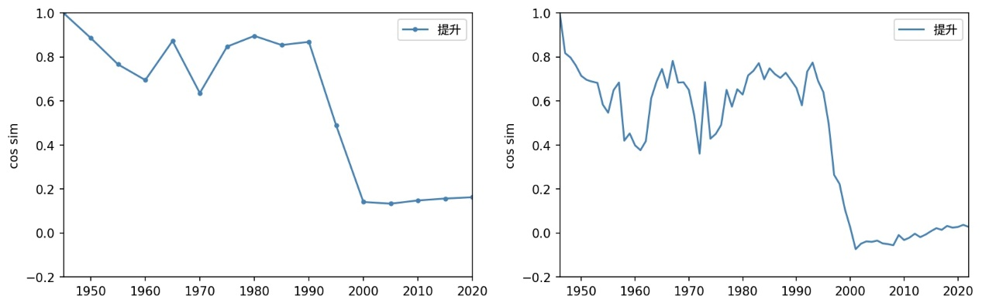
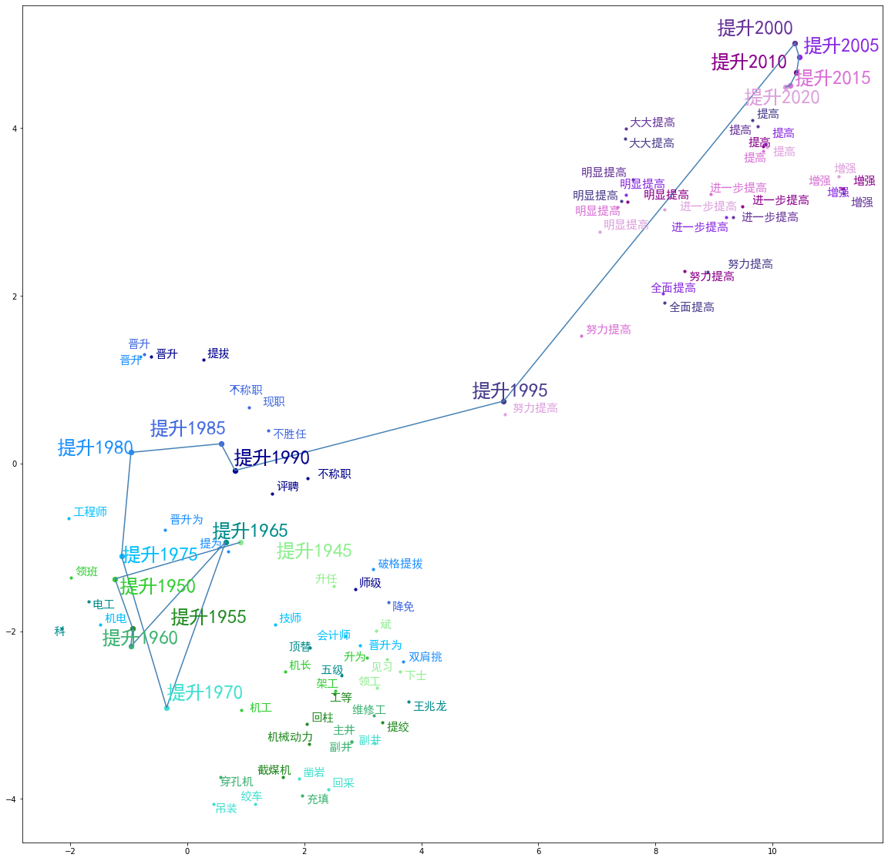
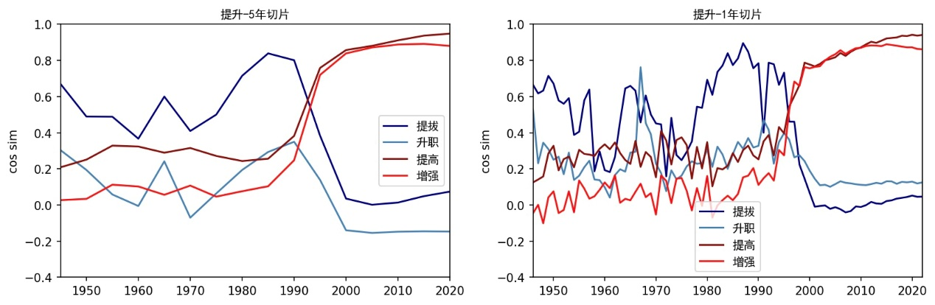
Case Study: “提升” (raise) promote --> improve
Time | Nearest Neighbours
1946-1949 1950-1954 1960-1964 1965-1969 1975-1979 1980-1984 1985-1989 1990-1994 1995-1999 2000-2004 2005-2009 2010-2014 2015-2019 2020-2022 | 升任 (promote), 见习 (intern) 机长 (captain), 领班 (foreman) 维修工 (maintenance man) 电工 (electrician), 顶替 (replace) 工程师 (engineer), 晋升为 (promote to) 晋升为 (promoted to), 晋升 (promoted) 现职 (current position), 降免 (demote) 晋升 (promoted), 提拔 (promote) 提高 (improve), 大大提高 (greatly improve) 提高 (improve), 进一步提高 (further improve) 提高 (improve), 增强 (increase) 提高 (improve),增强 (increase) 提高 (improve),进一步提高 (further improve) 提高 (improve),增强 (increase)
Notes:
As for my ongoing work, here is a case study of the word “提升”. Before 1995, its neighbourhood includes verbs like “promote”, and nouns, positions and occupations like foreman, captain; after 1995, its neighbours are replaced by verbs “improve” and “increase”, the meaning changes from assign someone to a higher position to make something better, which is more general and abstract, so we may say the word has undergo sense broadening. (pic) We compare its embeddings’ cosine similarly to the starting slice on both 5-year and 1-year scale, and the sharpest drops occurs around 1995; (pic) we also compare how similar are the embeddings to the old neighbours moving out, “promote”, “getting promoted”, marked in blue, and new neighbours moving in, “improve”, “increase” marked in red, the change is also the most obvious around 1995.

Slide 17
Temporal Word Analogy Task: Politicians
Year | Analogy
1949-1959 1960-1966 1966-1975 1976-1978 1981-1985 1986-1993 1994-2002 2003-2012 2013-2022 | 毛泽东 Mao Zedong 刘少奇 Liu Shaoqi 毛泽东 Mao Zedong 华国锋 Hua Guofeng 胡耀邦 Hu Yaobang 邓小平 Deng Xiaoping 江泽民 Jiang Zeming 胡锦涛 Hu Jingtao 习近平 Xi Jingping
Year | Analogy
1946-1952 1953-1959 1961 1963 1973-1974 1975-1976 1977-1981 1982-1988 1989-1992 1993-2001 2002-2008 2009-2016 2017-2020 2021-2022 | 杜鲁门 Truman 艾森豪威尔 Eisenhower 肯尼迪 Kennedy 约翰逊 Johnson 尼克松 Nixon 福特 Ford 卡特 Cater 里根 Reagan 布什 Bush 克林顿 Cliton 布什 Bush 奥巴马 Obama 特朗普 Trump 拜登 Biden
Notes:
Temporal analogy task does not reflect changes within the language itself, but rather how changes of the outside world result in different words, names or entities occupying the semantic space for a changing concept. For example, when it comes to politicians, we have president of China and president of US, asking questions, Xi Jingping in 2022 is like a certain someone in 1949, and we would expect the name to be Mao Zedong, Biden in 2022 is like someone in 2018, and we expect the answer to be Trump. We compare the results from the temporal word embedding to the actual presidents, it works well for presidents of China and the US, but not so well for other politicians like UK prime minister.

Slide 18
Temporal Word Analogy Task: Lifestyle
Year | Analogy
1946-1950 1951-1979 1980-1993 1994-1999 2001 2002-2007 2008-2013 2014-2022 | 信件 letter 信函, 书信 letter 电话 telephone 传真 fax 电子邮件 e-mail 短信 text QQ 微信 WeChat
Year | Analogy
1946-1962 1964-1974 1976-1996 1997-1998 2001-2009 2010-2022 | 书报 newspaper 广播电台 radio 栏目 column 网址 website 搜狐网 Sohu.net 微博 Weibo
Notes:
There are also temporal analogy on how people’s lifestyle changes. There is the semantic space for “means of communication”, messenger app WeChat in 2022 is like text in the early 21st century, fax in the 90s, telephone in the 80s, letter in the 50 to 70s. Also we have “people’s way of getting information”, social media and news platform Weibo in 2022 is like news website Souhu.net in early 21st century, radio broadcast in the 70 and 80s, newspaper in the 50 and 60s. From these temporal analogies we can see when and how one new thing appears to replace an old one.

Slide 19
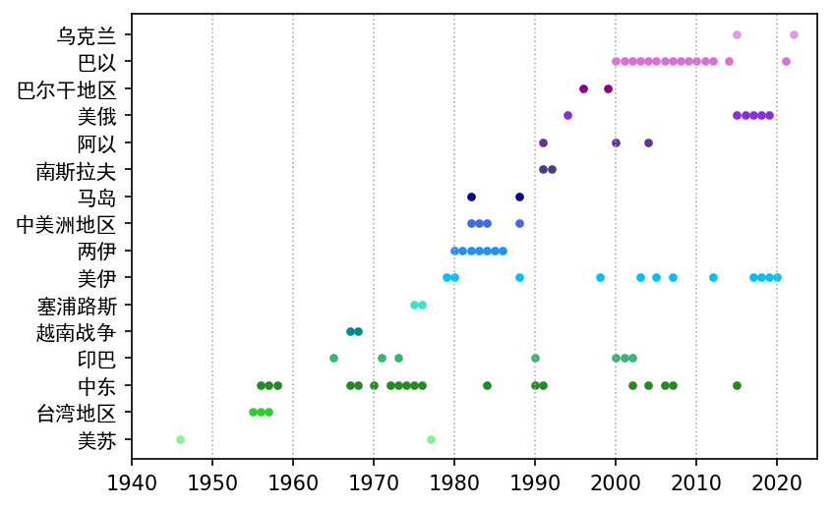
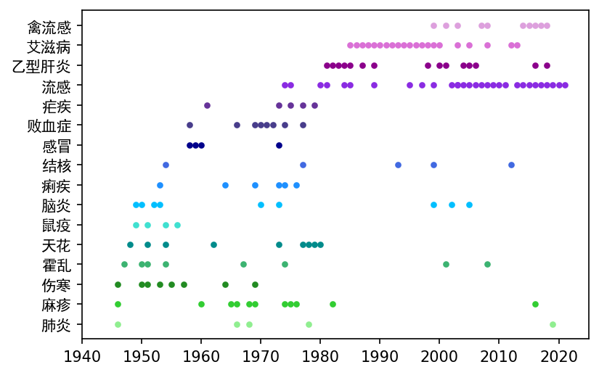
Temporal Word Analogy Task: Events
Ukraine
Pakistan-Israel
Balkans
US-Russia
Arab-Israel
Yugoslavia
Falkland Islands
Central America
Iran-Iraq
US-Iraq
Cyprus
Vietnam War
India-Pakistan
Middle East
Taiwan
US-Soviet
Crimea
bird flu
AIDS
HBV
flu
malaria
sepsis
influenza
TB
diarrhea
encephalitis
plague
variola
cholera
typhoid
measle
pneumonia
Israeli-Palestinian conflict
Yugoslavia wars
Falklands war
Iran-Iraq war
Turkish invasion of Cyprus
Second Taiwan Strait Crisis
Notes:
The temporal world analogy task can also be used to capture real-life events, which is something we would expect the news corpus to be naturally good at. For pandemic of infectious disease, we have Covid in 2022 is like, well, all these diseases in these specific years, I plan to verify them against records of the Chinese National Health commission. (pic) And for wars and armed conflicts, we have Russia-Ukraine in 2022 is like the Second Taiwan Strait Crisis in mid 1950s, Turkish invasion of Cyprus in 1974, the Iran-Iraq war from 1980 to 1988… It also managed to find out when Ukraine was last involved in a conflict, 2014, when Crimea was incorporated into Russia.

Slide 20
Project Management (Timeline)
Part-time working on dissertation until June
February – March (term 2): background research, data collection and preprocessing, experiment with Word2Vec alignment strategies
April (Easter break): model tuning, analysis of preliminary results
May – June 7th (exams): model tuning + analysis (case studies) continued
Full-time working from June onwards
3-4 weeks: experiment with BERT-based model and clustering (coding)
3-4 weeks: model tuning + result analysis (case studies)
3-4 weeks: writing the report
Notes:
Finally, here is my project timeline, I must work part-time on the dissertation until June because of lectures, coursework assignment and exams. So far, I have completed the background research, data collection and preprocessing, as well as building and tuning the Word2Vec based model and some preliminary analysis, which I plan to continue with throughout the exam month. From June onwards I shall be able to solely focus on the project, then it’s a month on building the BERT-based sense clustering model, a month on model tuning and result analysis including the case studies, and a month on reviewing, summarizing my work and writing the final report. That’s all for my presentation, do you have any questions?

